Slide 1

UNIVERSITI TEKNOLOGI MALAYSIA
TOPIC 3: SOFTWARE LIFECYCLE MODEL - PLANNED AND AGILE DRIVEN

Slide 2
Outline
Software Lifecycle Model
  PLANNING
  REQUIREMENTS ENGINEERING
  SOFTWARE DESIGN
  CODING AND TESTING
  MAINTAINANCE
Planned Driven Software Process Models
  WATERFALL MODEL
  INCREMENTAL MODEL
Agile Driven Software Process Models
  SCRUM
  KANBAN
  HYBRID AGILE MODEL

Slide 3
PLAN-DRIVEN SOFTWARE PROCESS MODELS

Slide 4
Objectives
Learning Objectives:
Understand the Software Lifecycle Model:
  Students will be able to define and explain the key phases of the software lifecycle, including planning, requirements engineering, software design, coding and testing, and maintenance.
Understand Planned Driven Software Process Models:
  Students will be able to explain the Waterfall and Incremental models, describing their processes, applications software development
Explore Agile Driven Software Process Models:
  Students will gain an understanding of Agile methodologies, focusing on the Scrum, Kanban, and Hybrid Agile models, and how these approaches emphasize flexibility and iterative development.

Slide 5
Software Lifecycle Model (SDLC)

Slide 6
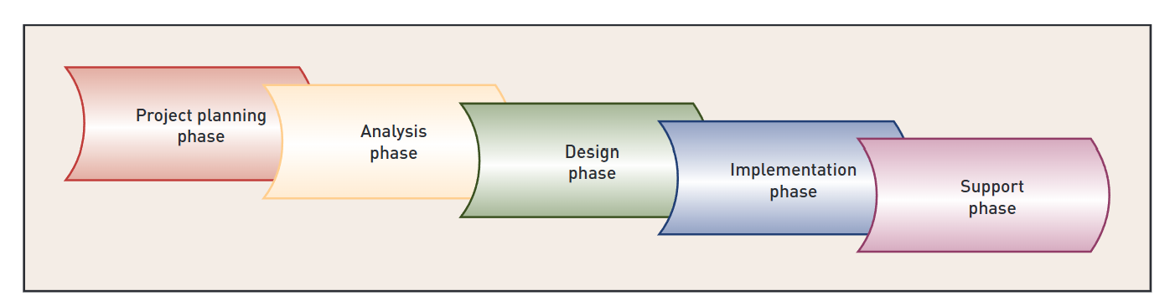
Software Development Lifecycle (SDLC)

Slide 7
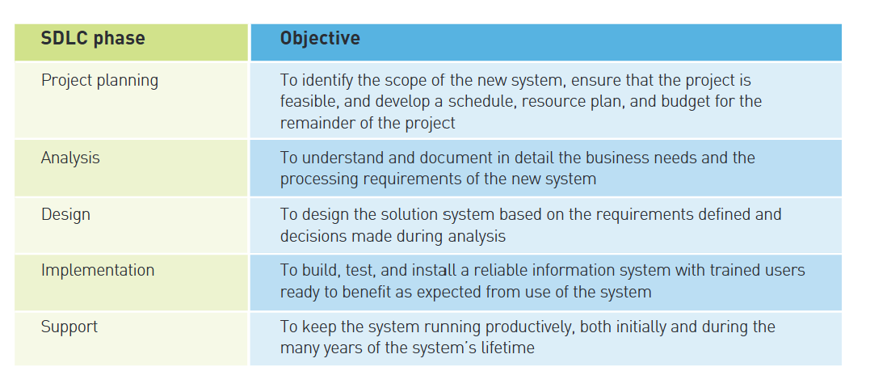
Software Development Lifecycle (SDLC)

Slide 8
Planned Driven Software Process Models

Slide 9
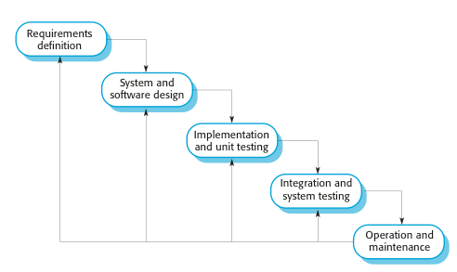
(1) The Waterfall Model

Slide 10
Waterfall Model Phases
There are separate identified phases in the waterfall model:
  Requirements analysis and definition
  System and software design
  Implementation and unit testing
  Integration and system testing
  Operation and maintenance
The main drawback of the waterfall model is the difficulty of accommodating change after the process is underway
In principle, a phase has to be complete before moving onto the next phase

Slide 11
Waterfall Model Problems
Inflexible partitioning of the project into distinct stages makes it difficult to respond to changing customer requirements
  Therefore, this model is only appropriate when the requirements are well-understood and changes will be fairly limited during the design process
  Few business systems have stable requirements
The waterfall model is mostly used for embedded systems (software must interface with hardware), critical systems, and large systems (system is developed at several sites)
  In those circumstances, the plan-driven nature of the waterfall model helps coordinate the work

Slide 12
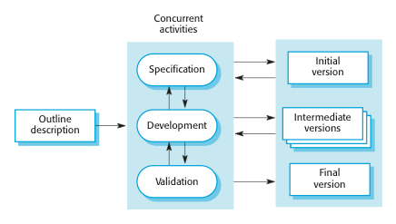
(2) Incremental Development

Slide 13
Incremental Development
In a plan-driven approach, the system increments are identified in advance
If an agile approach is adopted, the early increments are identified, but the development of later increments depends on progress and customer priorities
Each increment or version of the system incorporates some of the functionality that is needed by the customer
Generally, the early increments of the system include the most important or most urgently required functionality.

Slide 14
Incremental Development Benefits
The cost of accommodating changing customer requirements is reduced
  The amount of analysis and documentation that has to be redone is much less than is required with the waterfall model
It is easier to get customer feedback on the development work that has been done
  Customers can comment on demonstrations of the software and see how much has been implemented
More rapid delivery and deployment of useful software to the customer is possible
  Customers are able to use and gain value from the software earlier than is possible with a waterfall process

Slide 15
Incremental Development Problems
The process is not visible
  Managers need regular deliverables to measure progress
  If systems are developed quickly, it is not cost-effective to produce documents that reflect every version of the system
System structure tends to degrade as new increments are added
  Unless time and money is spent on refactoring to improve the software, regular change tends to corrupt its structure
  Incorporating further software changes becomes increasingly difficult and costly

Slide 16
AGILE SOFTWARE PROCESS MODELS

Slide 17
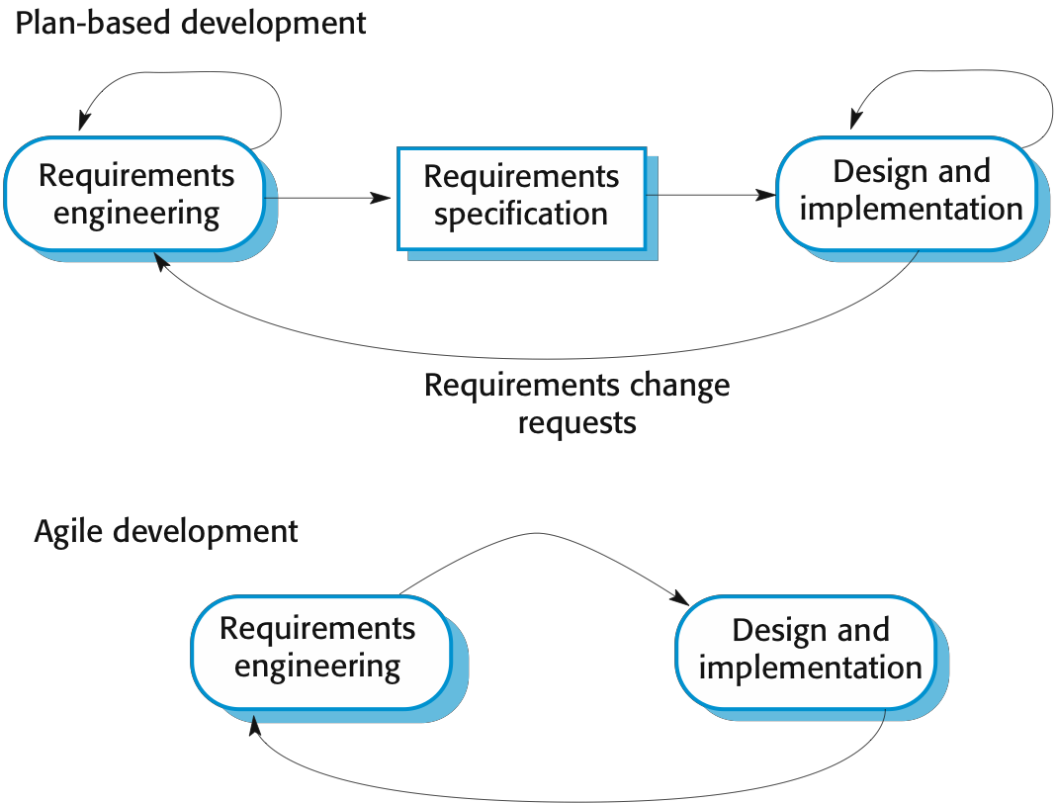
Plan-Driven and Agile Development…

Slide 18
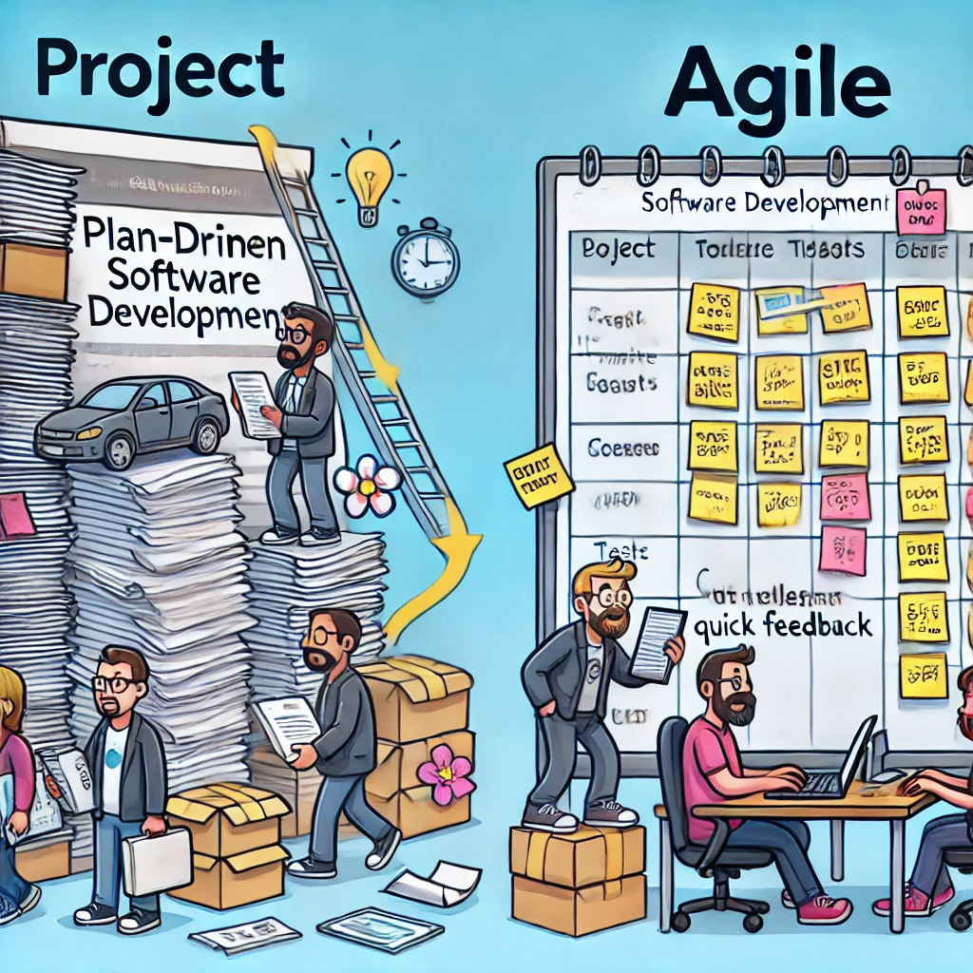
PLAN-DRIVEN TEAM is based separate development stages with the outputs to be produced at each of these stages planned in advance and documentation
AGILE TEAM
Deliver ideally 2-3 weeks
  Specification, design, implementation and testing are inter-leaved and the outputs from the development process are decided through a process of negotiation during the software development process
Plan-driven

Slide 19

Agile Manifesto
Source: http://agilemanifesto.org
The philosophy emphasizes flexibility and producing software quickly and capably.
“We are uncovering better ways of developing software by doing it and helping others do it. Through this work we have come to value:
  Individuals and interactions over processes and tools
  Working software over comprehensive documentation
  Customer collaboration over contract negotiation
  Responding to change over following a plan
That is, while there is value in the items on the right, we
value the items on the left more.”

Slide 20
The Principles of Agile Methods
Principle | Description
Customer involvement | Customers should be closely involved throughout the development process. Their role is to provide and prioritize new system requirements, select the features to be included in each successive build and to evaluate the iterations of the system.
Incremental delivery | The software is developed in increments with the customer specifying the requirements to be included in each increment.
People not process | The skills of the development team should be recognized and exploited. Team members should be left to develop their own ways of working without prescriptive processes.
Embrace change | Expect the system requirements to change and so design the system to accommodate these changes.
Maintain simplicity | Focus on simplicity in both the software being developed and in the development process. Wherever possible, actively work to eliminate complexity from the system.

Slide 21
Agile Methods Applicability
Product development where a software company is developing a small or medium-sized product for sale
  Virtually all software products and apps are now developed using an agile approach
Custom system development within an organization, where:
  there is a clear commitment from the customer to become involved in the development process
  there are few external rules and regulations that affect the software

Slide 22
AGILE DEVELOPMENT TECHNIQUES

Slide 23
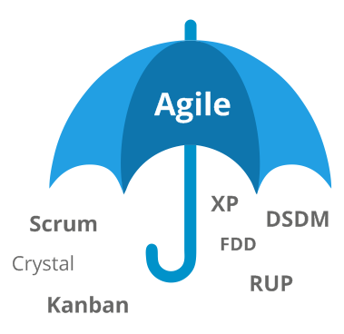
Agile Development Techniques
Hybrid Agile Model

Slide 24
Extreme Programming (XP)
A very influential agile method, developed in the late 1990s, that introduced a range of agile development techniques
Extreme Programming (XP) takes an ‘extreme’ approach to iterative development:
  New versions may be built several times per day
  Increments are delivered to customers every 2 weeks
  All tests must be run for every build and the build is only accepted if tests run successfully

Slide 25

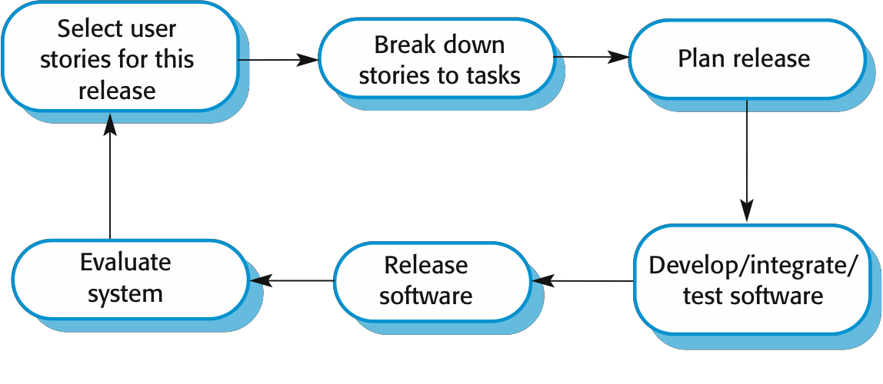
The Extreme Programming
Release Cycle
Requirements & Analysis
Time & cost estimates are given to the
customer

Slide 26
AGILE PROJECT MANAGEMENT

Slide 27
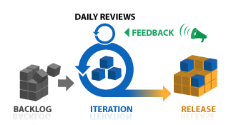
Agile Project Management
The principal responsibility of software project managers is to manage the project so that the software is delivered on time and within the planned budget for the project
The standard approach to project management is plan- driven
Managers draw up a plan for the project showing what should be delivered, when it should be delivered and who will work on the development of the project deliverables
Agile project management requires a different approach, which is adapted to incremental development and the practices used in agile methods
© http://www.planbox.com/resources/agile-
project-management

Slide 28
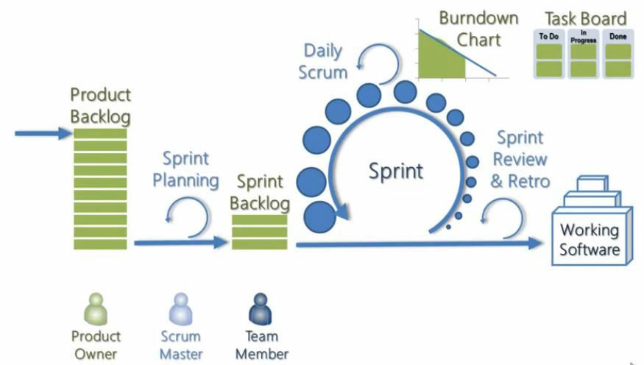
The Scrum Process

Slide 29
Scrum Analogy
Building a house, room by room, with regular feedback:
Product Backlog: Imagine you are building a house and have a complete list of features you want (rooms, kitchen, bathrooms). This is your product backlog.
Sprint Planning: Each sprint is like choosing one room to build (e.g., the kitchen). The team discusses the details of what needs to be done for this room during sprint planning.
Sprint: During the sprint, the construction team focuses solely on building that one room. They hold daily meetings (daily Scrums) to ensure everyone is on the same page and progress is being made.
Task Board and Burndown Chart: The task board is like a construction to-do list, showing what's done, in progress, or yet to be started. The burndown chart tracks how quickly work is being completed, ensuring the project is on schedule.
Sprint Review & Retrospective: Once the room (sprint) is finished, the team meets for a review with the homeowner (product owner) to ensure it meets expectations. They also hold a retrospective to reflect on what went well or what could be improved before starting the next room.
Working Software: After each sprint, a part of the house is complete and functional, much like how a working increment of software is produced after each sprint.

Slide 30
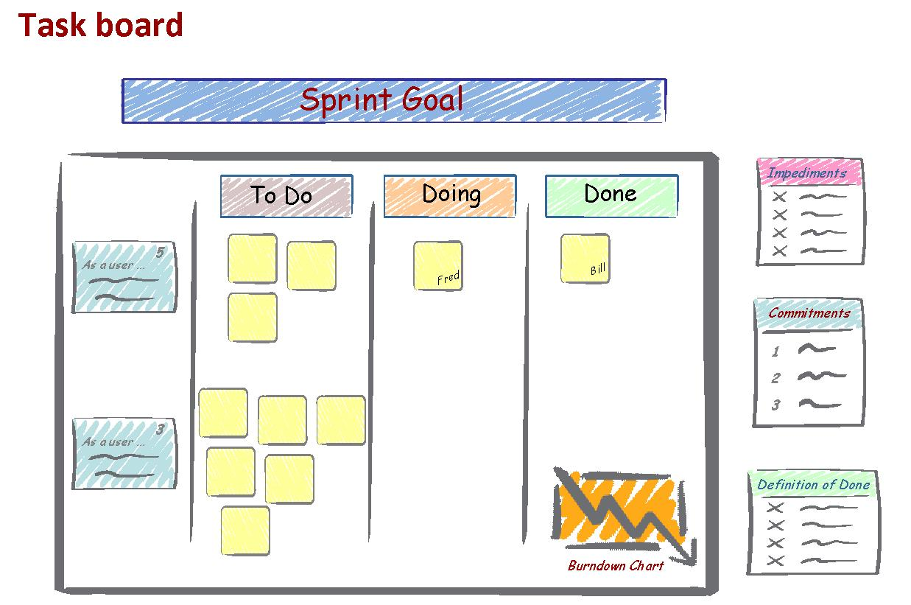
Task Board

Slide 31
The Scrum Sprint Cycle
Sprints are fixed length, normally 2–4 weeks
The starting point for planning is the product backlog, which is the list of work to be done on the project
The selection phase involves all the project team members who work with the customer to select the features and functionality from the product backlog to be developed during the sprint

Slide 32
The Sprint Cycle
Once these are agreed, the team organize themselves to develop the software
During this stage the team is isolated from the customer and the organization, with all communications channelled through the so-called ‘Scrum master’
The role of the Scrum master is to protect the development team from external distractions
At the end of the sprint, the work done is reviewed and presented to stakeholders
The next sprint cycle then begins

Slide 33

Teamwork in Scrum
The ‘Scrum master’ is a facilitator who arranges daily meetings, tracks the backlog of work to be done, records decisions, measures progress against the backlog and communicates with customers and management outside of the team
The whole team attends short daily meetings (Scrums) where all team members share information, describe their progress since the last meeting, problems that have arisen and what is planned for the following day
This means that everyone on the team knows what is going on and, if problems arise, can re-plan short-term work to cope with them

Slide 34
Scrum Benefits
The product is broken down into a set of manageable and understandable chunks
Unstable requirements do not hold up progress
The whole team have visibility of everything and consequently team communication is improved
Customers see on-time delivery of increments and gain feedback on how the product works
Trust between customers and developers is established and a positive culture is created in which everyone expects the project to succeed

Slide 35
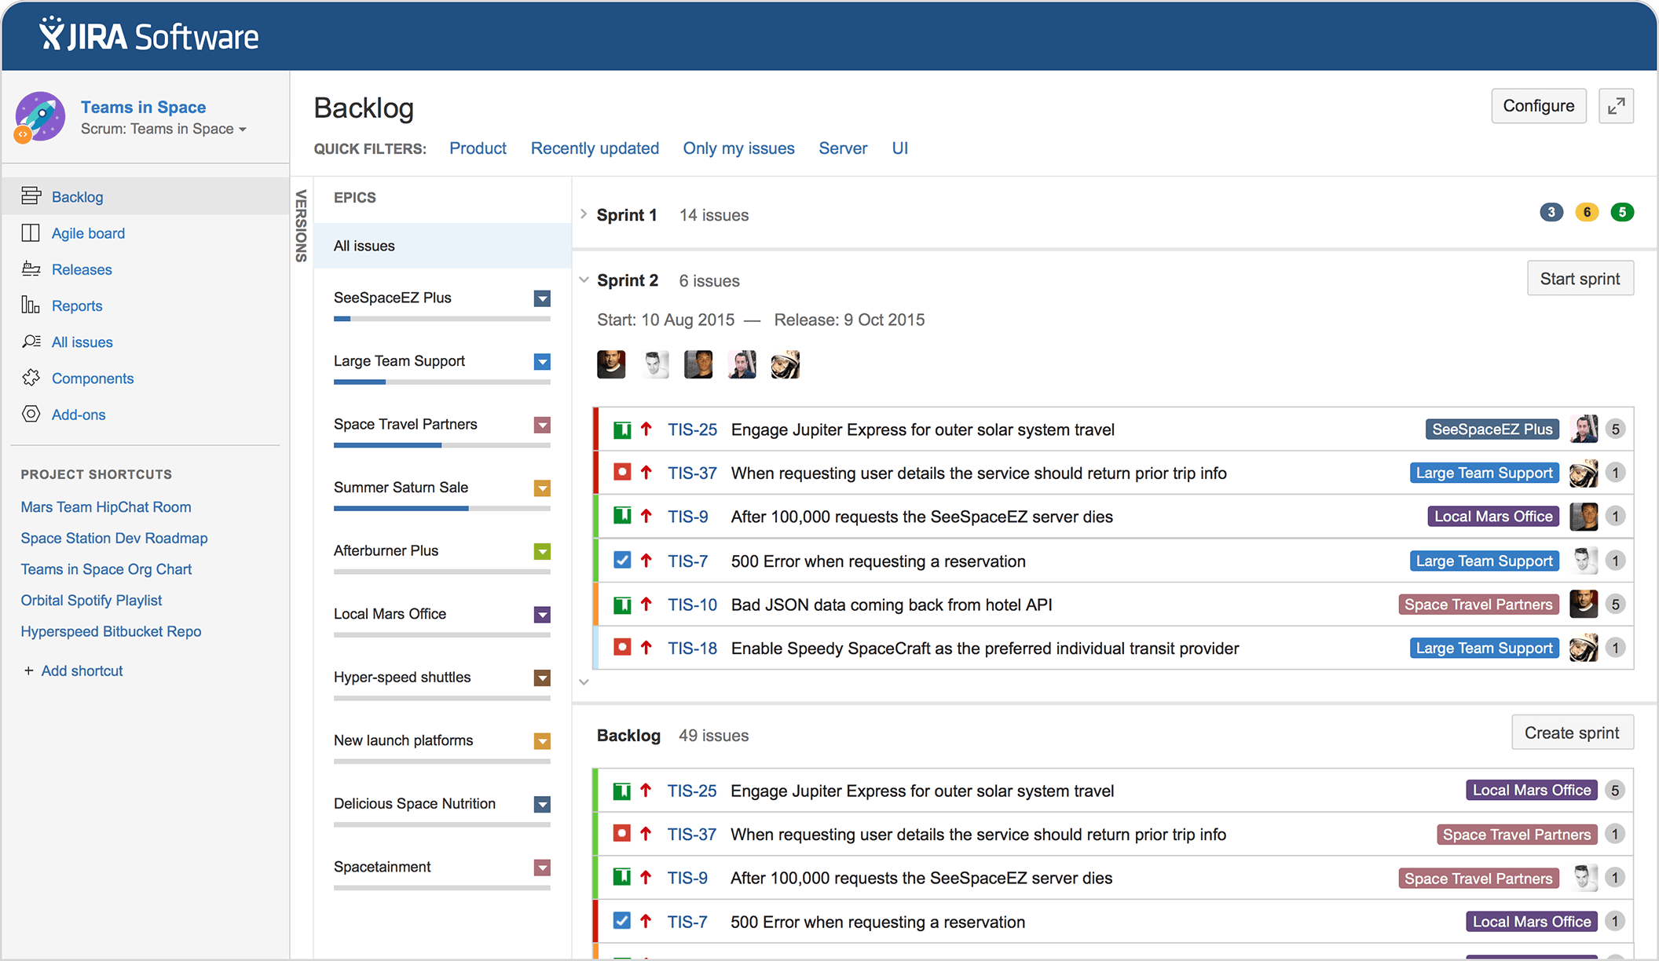
Example of Agile Project Management: JIRA Software

Slide 36
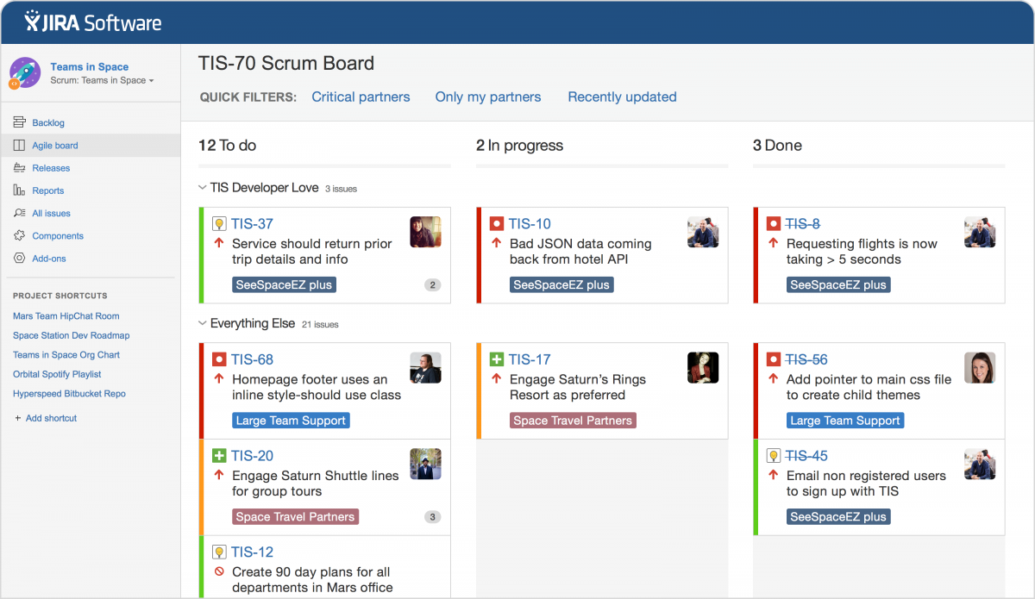
Example of Agile Project Management: JIRA Software

Slide 37
Agile (part 2 – Kanban and Hybrid Agile Model)

